Slide 1
Relational Database Design
Date of Presentation: 6/7/2023

Slide 2
Lesson 1: Entity-Relationship
Model
Gerald Balekaki

Slide 3
Outline
Introduction
Design process overview
Example: College database
Project overview
E-R notations
E-R model
Entities
Relationships
Attributes
Keys
Example: Conceptual design

Slide 4
Introduction

Slide 5
Introduction
Why relational DB design is important
To organise data for efficient storage, retrieval and management.
A well-designed DB serves as a backbone to any application in an organisation.
Relational DB design covers three key concepts
E-R model
Functional dependencies
Database normalization
Relational DB design follows a standard process
(next slide)

Slide 6
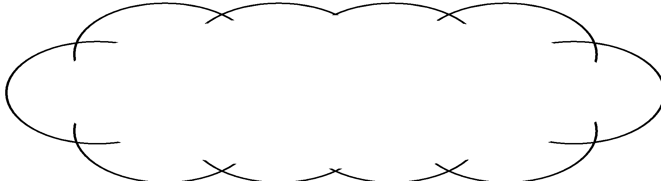
Overview: Design process
Main phases of DB Design process
Requirement Collection and Analysis
collect database needs from users/world
Conceptual Design
requirements translated into conceptual schema
indicates functional requirements of an entreprise
Logical Design (data model mapping)
transforms conceptual schema into specific DBMS data model
requires “good” collection of relation schemas (normalization of data)
Physical Design
specify file storage structures, index, and record placement (layout of the database on disk)
Implementation
database is implemented, tested, and deployed
World
Requirement Analysis
Conceptual Design
high-level data modeling
(E-R model)
Logical Design
data model mapping
Physical Design
Implementation

Slide 7
Entity-Relationship Model
(E-R Model)

Slide 8
E-R Model
E-R Model is conceptual framework for understanding and organizing the data elements (entities) and their associations (relationship) in a database
E-R modeling based on two key components:
Entity
Is a thing or object in the real world with an independent existence that can be differentiated from other objects,
Usually a noun in a business rule, e.g., “Author and Book” in “an author writes Books”
Relationship
Is an association or interaction between entities.
usually a verb, and bi-directional e.g., “writes/written” in “an author writes books, but each book is written by one author”.

Slide 9
Entity-Relational Notations
Three popular graphical notations for E-R diagrams:
Chen
rectangles are entities, diamonds are relationships, and ovals are attributes.
Cardinality and participation constraints as numbers near the relationship lines.
Unified Modeling Language (UML)
rectangles with the entity name inside are entities, lines are relationships, and attributes are listed within the entity rectangle.
Cardinality and participation constraints as multiplicity notations ("1", "0..1", "0..*") near the relationship lines.
Crow’s Foot
rectangles are entities, lines with crow's foot symbols are relationships, and attributes are listed within the entity rectangle.
Cardinality and participation constraints as crow's foot symbols ("|", "||", "o") near the entity ends of the relationship lines.

Slide 10
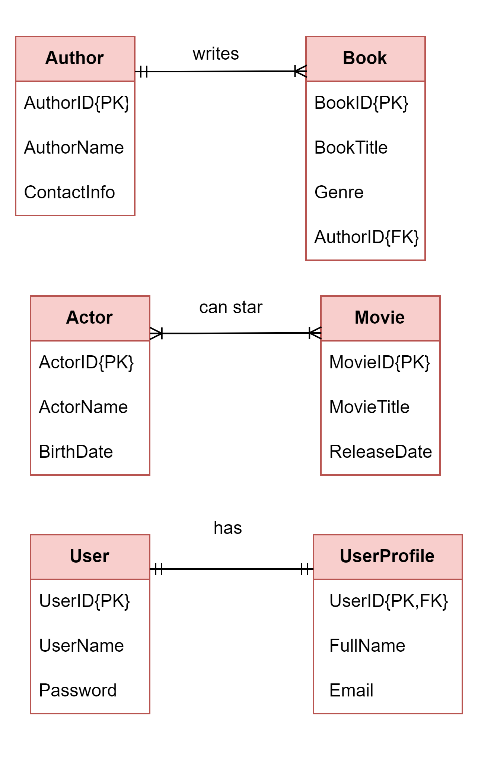
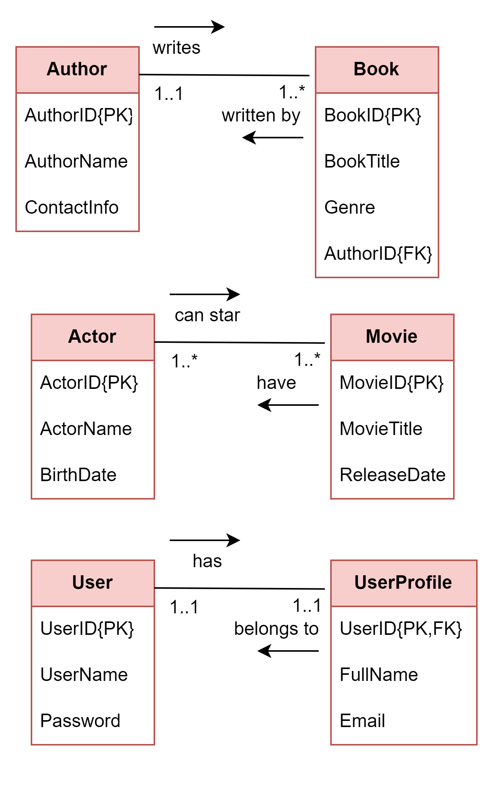
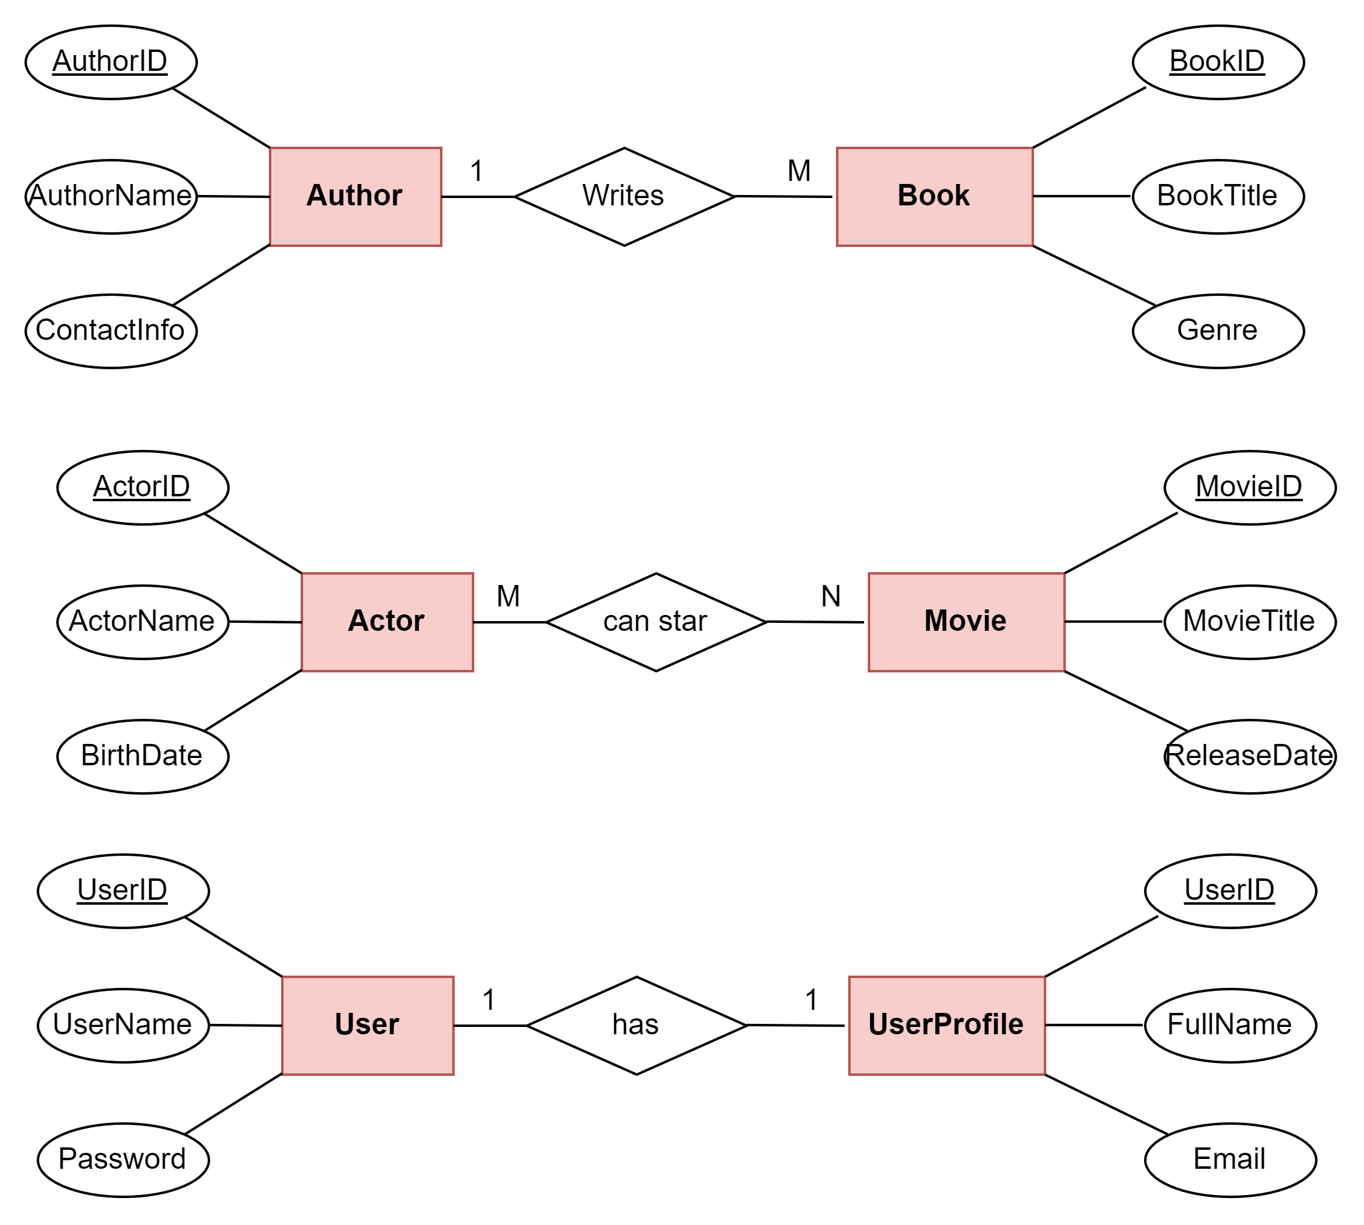
E-R Notations
Crow’s Foot Notation
Chen’s Notation
UML Notation
(a)
(d)
(g)

Slide 11
E-R Notations …cont’d
Crow’s Foot vs. Chen vs. UML
Business rule (a): One-to-Many (1:M)
One author can write multiple books, but each book is written by only one author.
Business rule (b): Many-to-Many (M:N)
An actor can star in multiple movies, and a movie can have multiple actors.
Business rule (c): One-to-One (1:1)
Each user has a profile and a profile belong to one and only one user.

Slide 12
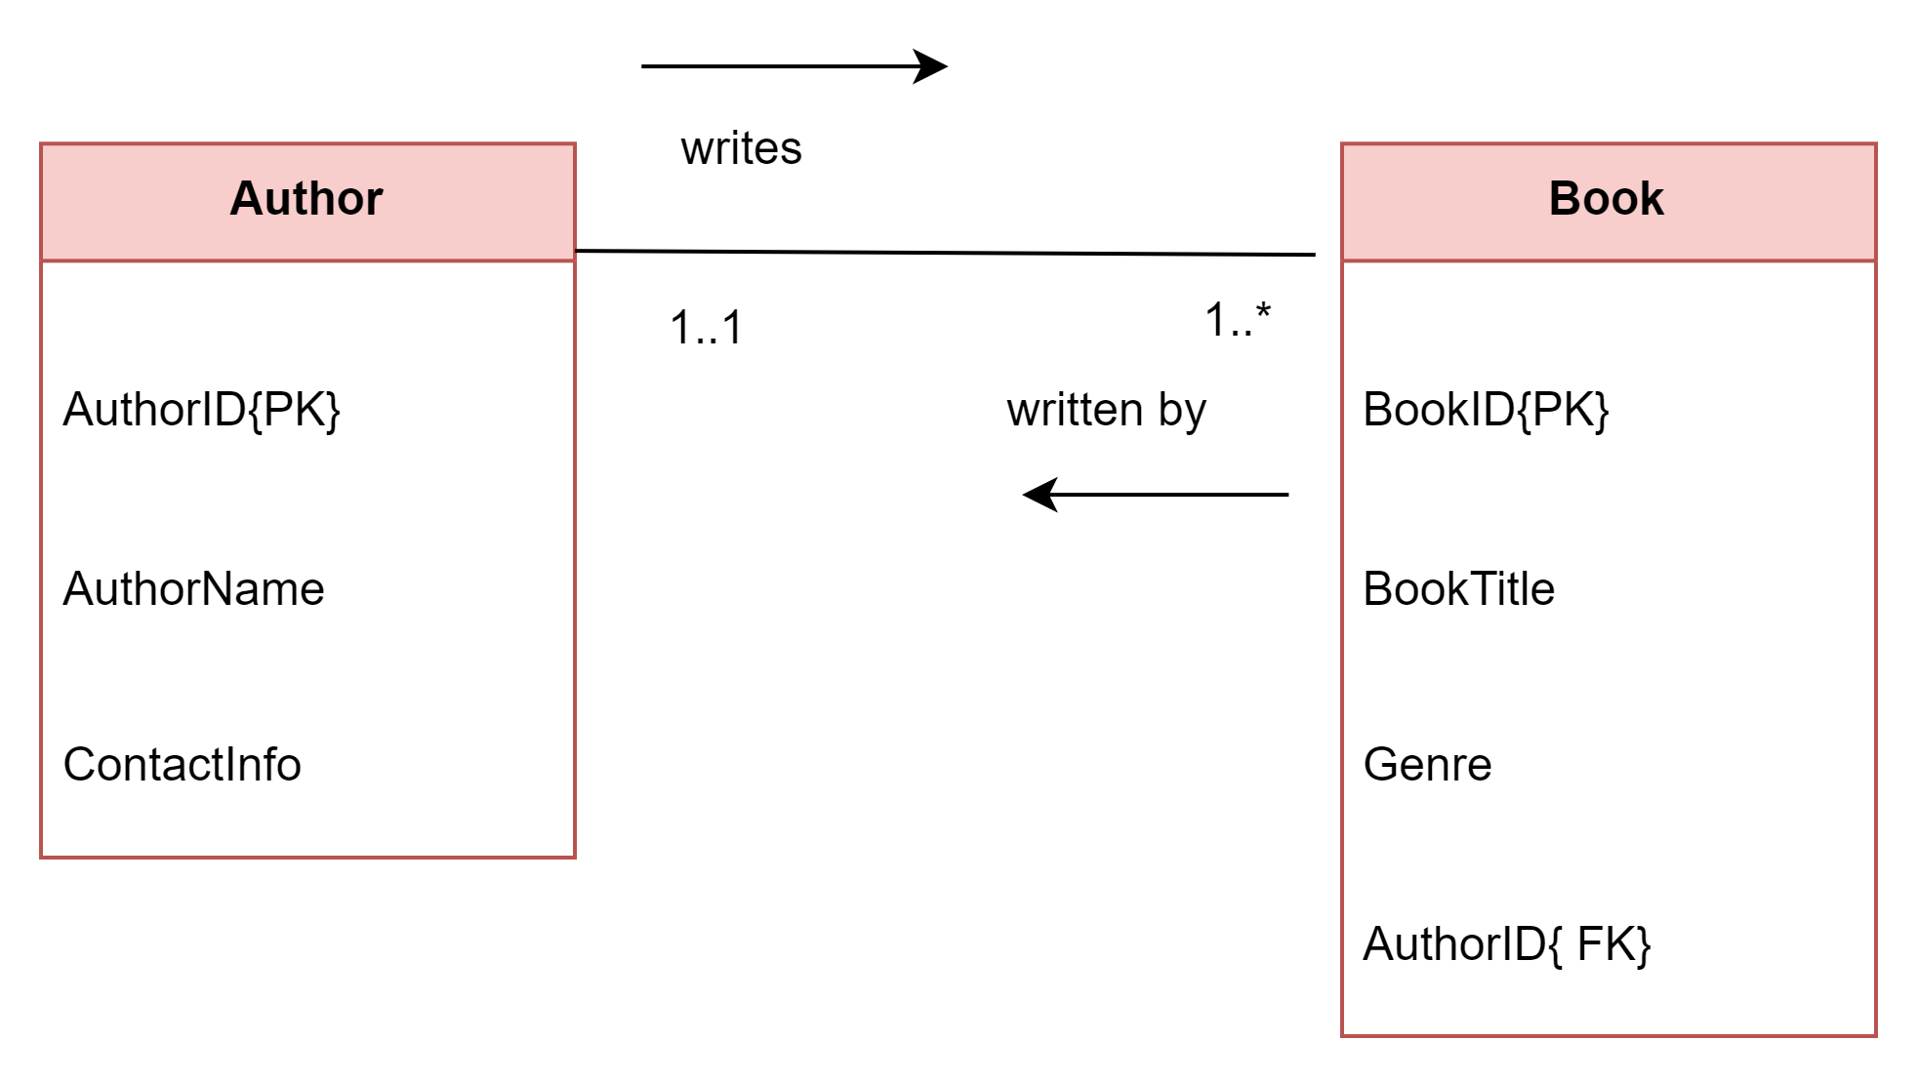
Basic E-R diagram (ERD) in UML
Entity (Author, Book)
Relationship (An author writes one or many Book, and each book is written by one and only one author).
Attributes (AuthorID, AuthorName, ContactInfo)
Primary keys - PK (AuthorID, BookID)
Foreign key - FK (AuthorID in Book entity)
Multiplicities (X,Y)
Participation (mandatory -1, optional- 0) ←X
Cardinality (to-one (1) to-many(*)) ←Y
Entity
Relationship
Primary
Key
Attributes
Foreign
Key
Multiplicities
(Participation + Cardinality)

Slide 13
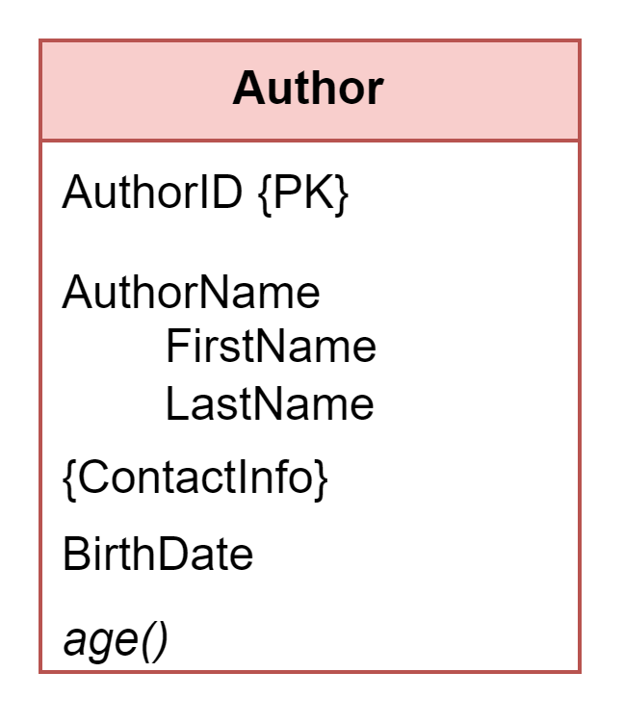
Attributes
Attributes
Single-valued (simple attributes)
can only have a single value e.g., the author’s name: “J.K Rowling”
Composite
can have an hierarchy of attributes e.g., author’s name can have FirstName and LastName.
Name should be split into two single-valued attributes.
Multi-valued
can have a set of values in each entity e.g., author’s Contact Info.
Derived
are computed from another existing attribute e.g. author’s Birth Date → age()
Composite
attribute
Simple
attributes
Multi-valued
attribute
Derived
attribute
Note: composite and multi-valued attributes appear differently in relation schema (at logical level), whereas derived attributes are not included.

Slide 14
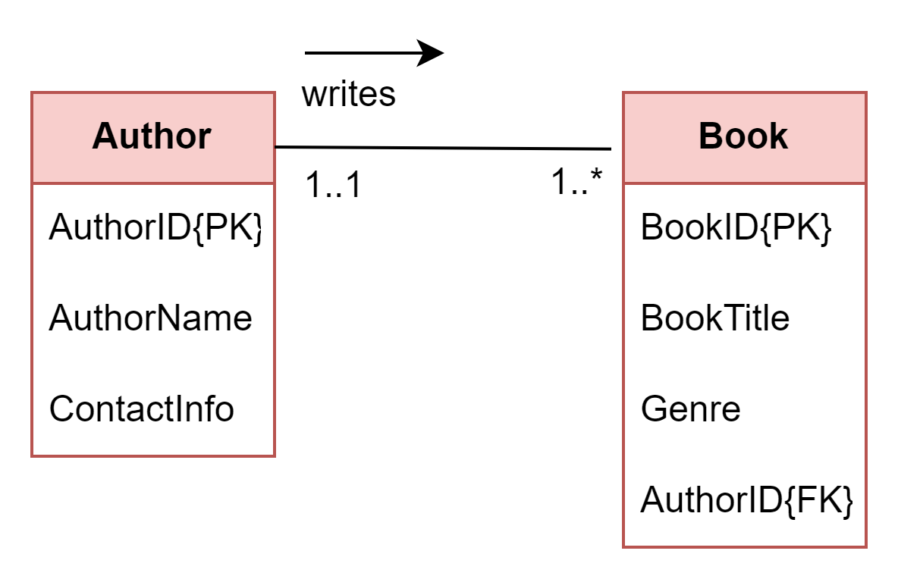
Multiplicity
(Participation and Cardinality)
In a UML ERD, multiplicity is a combination of the participation and cardinality of the relationship.
Multiplicity = Participation + Cardinality
multiplicity format on both side is (min..max) or (x..y)
Cardinality (max)
Is the maximum number of times an instance in one entity can relate to instances of another entity.
It defines the type of relationship.
Participation (min)
Is the minimum number of entities that are involved – mandatory(1) or optional (0)
Frequently used min and max values
0 - zero
1 - one
* - many
Participation
Cardinality

Slide 15
… more relationships
Relationships - are associations between entities
operate in both directions
are classified as 1-to-1 (1:1), 1-to-many (1:M) or many-to-many(M:M)
For example: business rule in (a)
an author writes one or many books, but each book is written by one and only one author.
relationship name is “writes/written by”
multiplicity near book is 1..* (one or many).
multiplicity near author is 1..1 (one and only 1).
Write the business rules, relationship names, and multiplicities for (b) and (c).
Note:
Multiplicity in UML can be specific e.g, A book is written by at most 5 authors (i.e., 0..5 near Author entity)
(a)
(b)
(c)

Slide 16
Keys
A key used for identifying purposes in a specific entity is referred to a primary key (PK).
It must uniquely identify a row in a table and cannot be null e.g., AuthorID in Author table or BookID in Book table
Composite key –
– PK can consist of two or more attributes e.g., StudentNo + LastName.
Surrogate key –
– generated key (number) used as PK. It does have to mean anything to the database e.g., AuthorID 89471.
PK enforce entity integrity –
– ensures that there are no duplicate records within the table and that the field that identifies each record within the table is unique and never null.

Slide 17
Keys …cont’d
A foreign key (FK) –
– Is an attribute in a table that references the primary key in another table
It can be null.
PK and FK must be of the same data type.
FK enforce referential integrity –
–requires that a FK must have a matching primary key or it must be null.
This constraint is specified between two tables (parent and child entity) e.g., Author and Book
The integrity maintains the correspondence between rows in Author and Book via AuthorID (FK) – this reference must be valid.

Slide 18
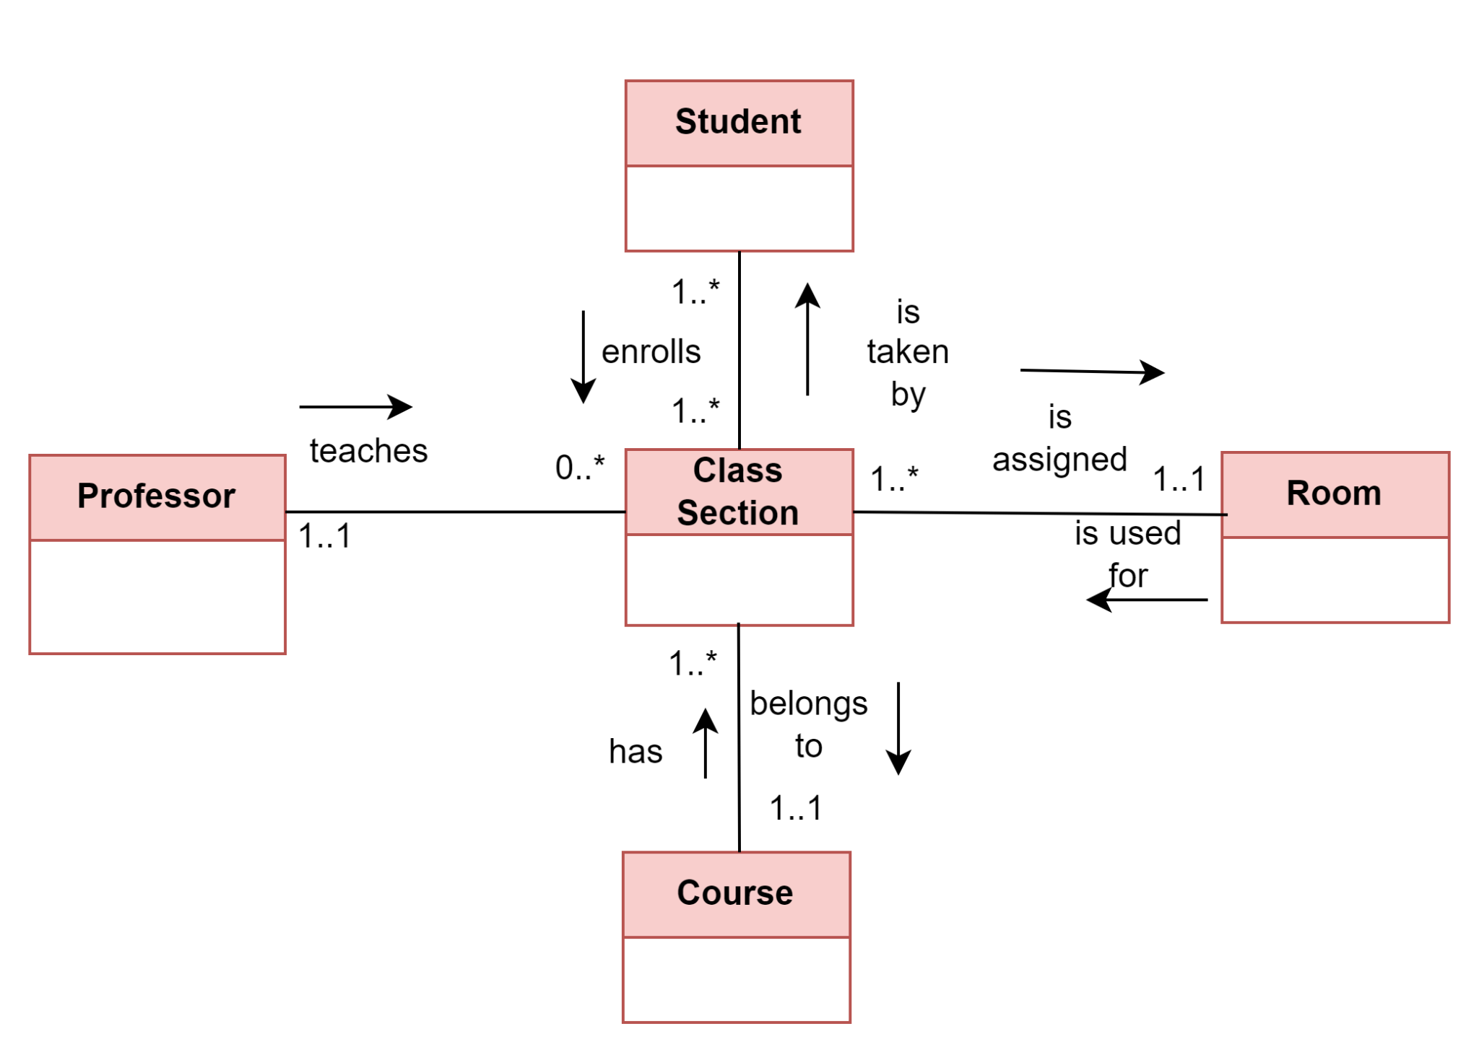
Example: College Database
Conceptual design in UML
ERD in UML showing main entities, relationships of a college database
A college stores information about students, professors, class sections, rooms, and courses.
A student must enroll in one or more class sections, but one class section is taken by many students.
Each class section is assigned a specific room, and each room can be used by several class sections.
Each professor may teach many class sections, and one class section must be taught by one professor.
A course has several class sections, and one class section belongs to a specific course.
Conceptual design for a College database using UML notation

Slide 19
Project: City Book Library Database
A City Book library seeks to store information about books, authors, staff, borrowers, and membership cards.
For each book, they want to record the ISBN (International Standard Book Number), title, pages, and genre. A book is written by exactly one author, but an author can write several books.
Each staff member may issue many books to a specific borrower, and each borrower can borrow many books in a single attempt.
A membership card is given to a specific borrower, and a borrower must own one card.
Activity 2.1
Draw a conceptual design ERD for the City Book Library using UML notation

Slide 20
Summary
Introduction
Design process overview
Example: College database
Project overview
E-R notations
E-R model
Entities
Relationships
Attributes
Keys
Example: Conceptual design
🡺NEXT
How to create a detailed ERD (Logical design)

